Slide 1
₦
BANK MARKETING CAMPAIGN ANALYSIS
Understanding the Drivers of Term Deposit Subscription
AnalystLab Africa Internship | Batch B | Week 5 Case Study
Prepared by Chidozie Williams Iheme

Slide 2
BUSINESS PROBLEM
Why Do Some Customers Subscribe
and Others Don't?
The Challenge
Guiding Questions
Why It Matters
A bank ran a term-deposit telemarketing campaign. Management needs to know which customers are most likely to respond, so future campaigns spend effort where it converts.
Which customer segments respond best to outreach? Which factors — age, job, education, prior contact history — most influence a 'yes'?
Untargeted campaigns waste call-center hours and frustrate customers who were never going to convert. Better targeting raises ROI on every contact made.
2

Slide 3
DATASET OVERVIEW
Bank Marketing Dataset
11,162
17
0
~47%
Customer Records
Attributes Captured
True Nulls (uses 'unknown')
Overall Subscription Rate*
Key Fields Used in This Analysis
age, job, marital, education — customer demographics
balance, housing, loan, default — financial profile
contact, month, day, campaign — outreach details
poutcome, pdays, previous — prior campaign history
duration — call length (outcome signal, not predictive input)
deposit (y) — target variable: subscribed or not
*Placeholder — replace with your actual GROUP BY result from Query 4
3

Slide 4
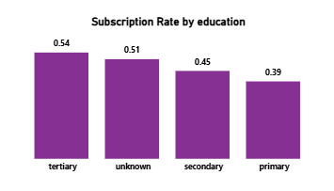
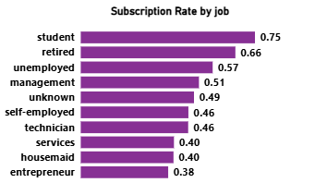
KEY VISUALIZATIONS
Subscription Rate by Job & Education
Placeholder data — replace with results from Queries 5 & 6
4

Slide 5
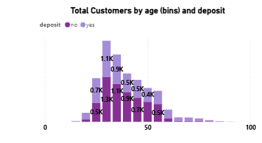
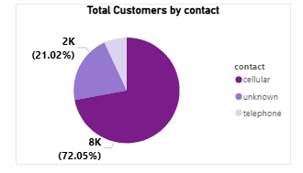
KEY VISUALIZATIONS
Total Customers by age(bins), deposit & Contact Method
Placeholder data — replace with results from Queries 9 & 10
5

Slide 6
MAJOR FINDINGS
What the Data Tells Us
01
Past success predicts future success
02
Retirees & students convert best
Customers with a prior successful campaign outcome subscribe at nearly double the rate of cold contacts.
These segments consistently out-convert blue-collar and admin roles, yet receive comparable outreach effort.
03
Contact fatigue is real
04
Timing shifts results
Subscription rate declines after repeated contact attempts within the same campaign — more calls isn't always better.
Subscription rates vary meaningfully by month, pointing to seasonal windows worth prioritizing.
6

Slide 7
RECOMMENDATIONS
What the Bank Should Do Next
1
Prioritize re-contacting customers with a prior successful campaign outcome — route them to the top of the call list.
2
Reallocate outreach effort toward retired and student segments with tailored messaging for each.
3
Cap contact attempts per customer per campaign to reduce fatigue and free up capacity for warmer leads.
4
Concentrate campaign intensity in historically high-converting months; scale back in low-performing months.
5
Use call duration as a coaching signal — study successful longer calls and train agents on those techniques.
7

Slide 8
Conclusion
Targeted Outreach Beats Broad Outreach
Subscription behavior is not random — it is concentrated in specific, identifiable segments: customers with prior success, retirees, students, and those contacted through the right channel at the right time. By focusing campaign effort on these signals rather than contacting the full customer base equally, the bank can raise conversion rates while reducing wasted call-center hours.
Prepared by Chidozie Williams Iheme
AnalystLab Africa Internship — Week 5
8

